Slide 1
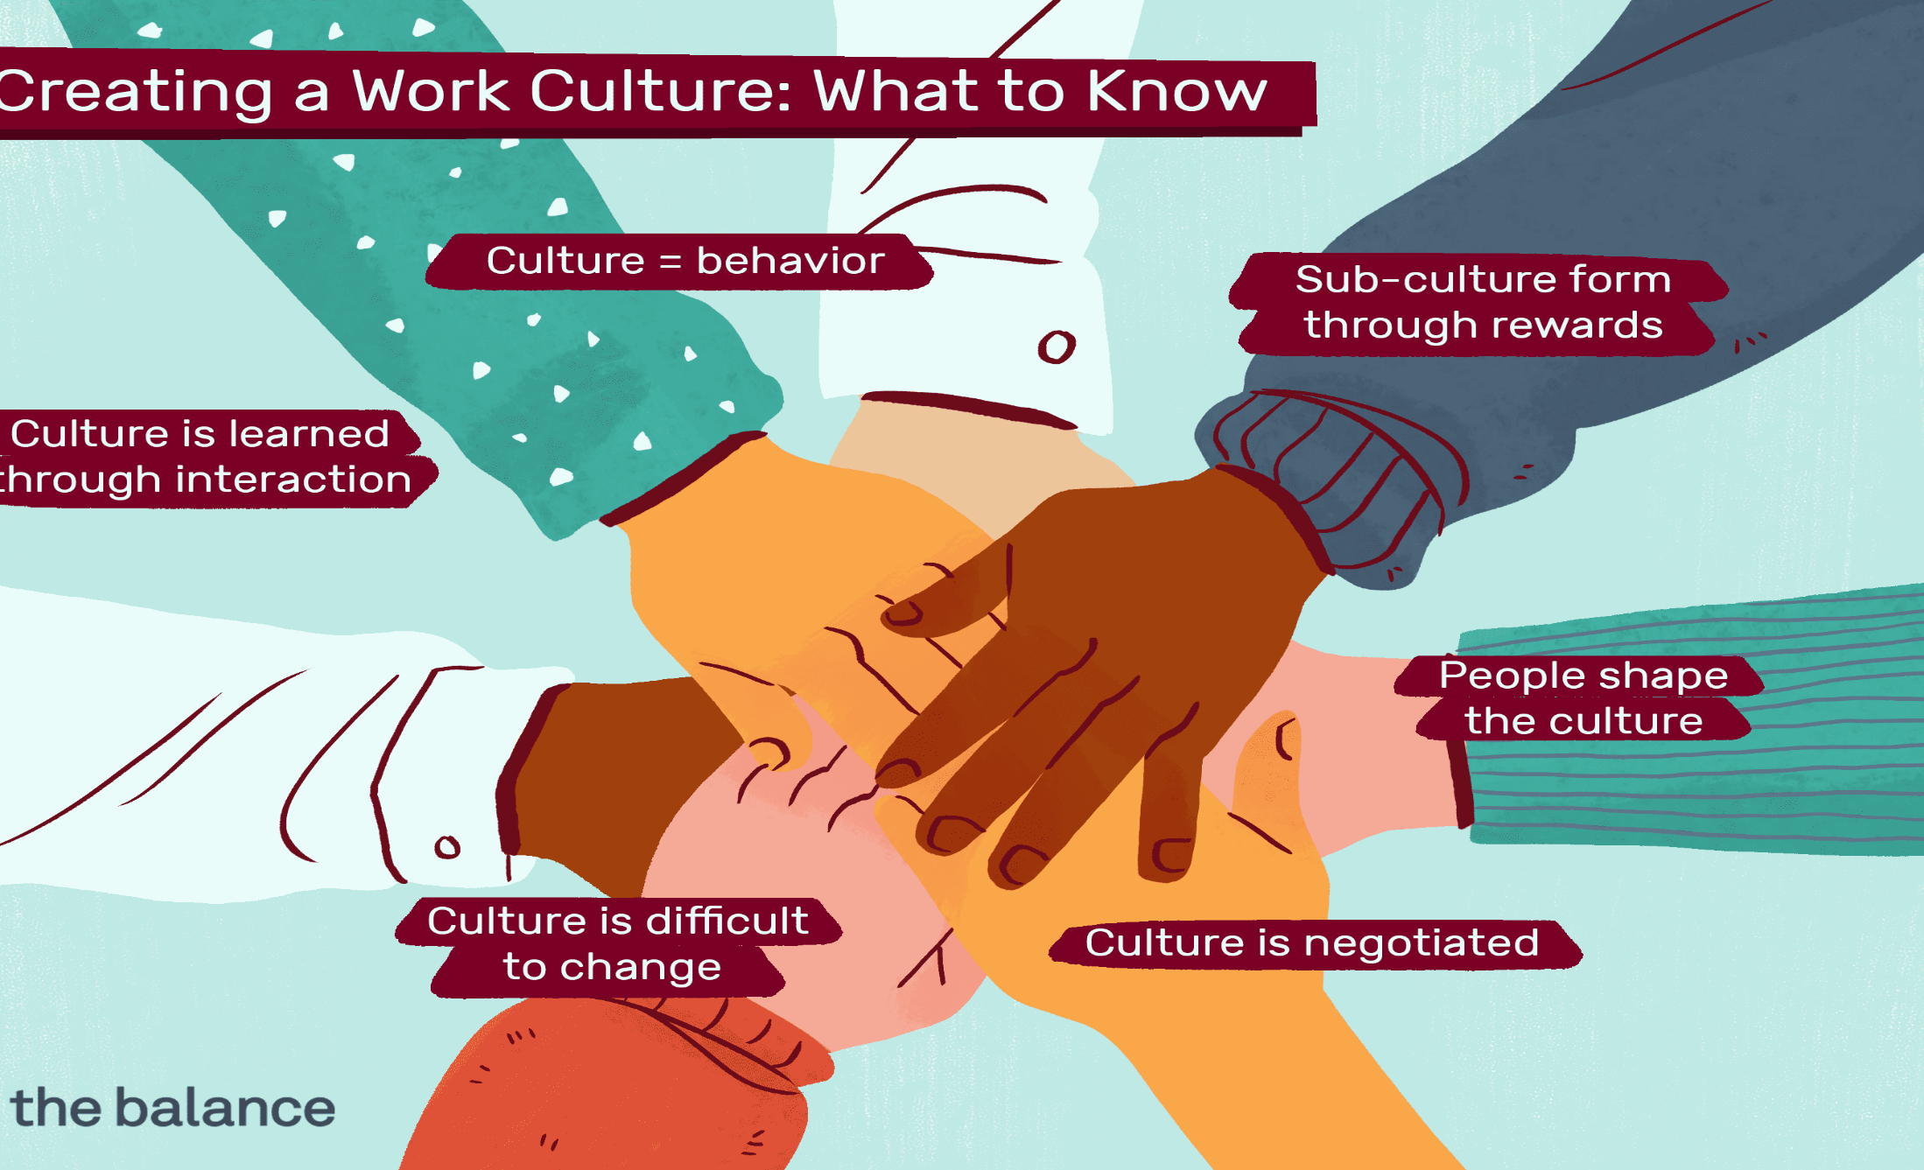
Unit 2

Slide 2

Why individual differences are important?
Individual differences have a direct effect on behavior
  People who perceive things differently behave differently
  People with different attitudes respond differently to directives
  People with different personalities interact differently with bosses, coworkers, subordinates, and customers

Slide 3


Slide 4
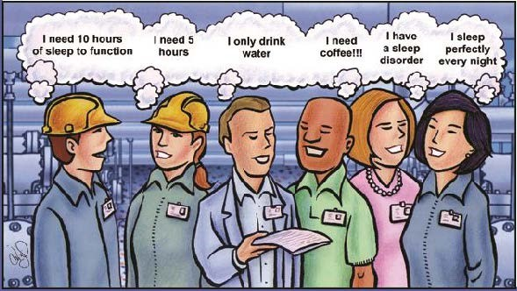
Why individual differences are important?
Individual differences help explain:
  Why some people embrace change and others are fearful of it
  Why some employees will be productive only if they are closely supervised, while others will be productive if they are not
  Why some workers learn new tasks more effectively than others

Slide 5

Attraction-Selection-Attrition (ASA)
Cycle
Different people are attracted to different careers and organizations as a function of their own:
Abilities
Interests
Personalities

Slide 6
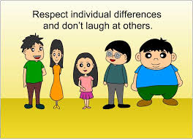
The Basis For Understanding Work
Behavior
To understand individual differences a manager must:
  Observe and recognize the differences
  Study relationships between variables that influence behavior

Slide 7
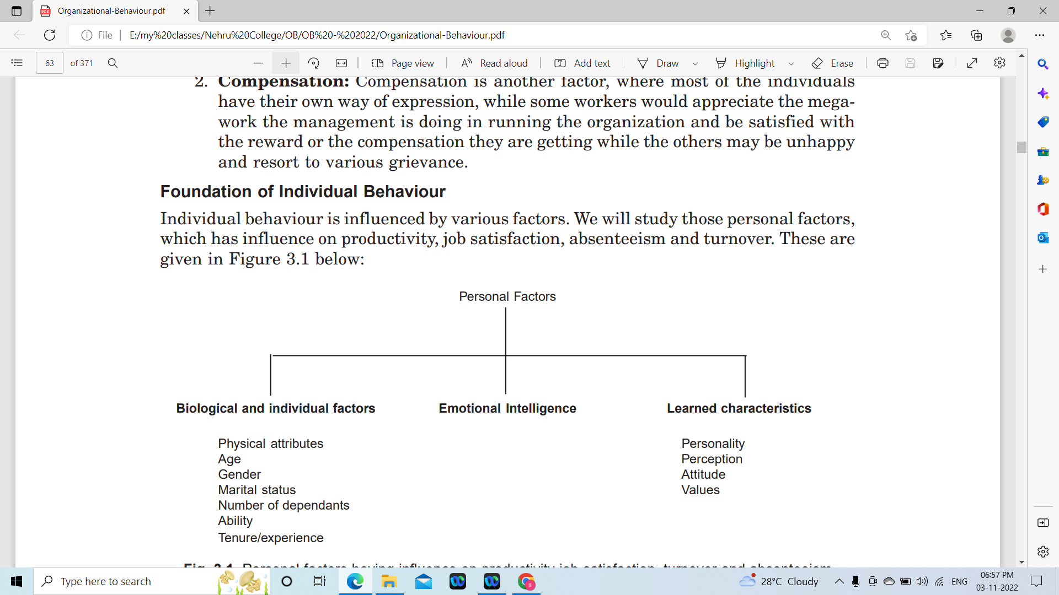
Personal Factors, Which Has Influence On Productivity, Job Satisfaction, Absenteeism And Turnover

Slide 8
Individual Differences
Influencing Work Behavior
Hereditary and Diversity Factors
Personality
Ability and Skills
Perception
Attitudes

Slide 9
Generational diversity
Disability Diversity
Diversity Factors

Slide 10

Disability Diversity

Slide 11
Generational Diversity
Gen Y : 20s and younger
Gen X: 30s to low 40s
Baby bommers: mid 40s and older

Slide 12

Abilities and Skills
Ability – a person’s talent to perform a mental or physical task
Skill – a learned talent that a person has acquired to perform a task

Slide 13
Personality
Environment
Heredity
Attitude
Values
Personality is sum total of ways in which an individual reacts and interacts with others. It is a dynamic organization within an individual of those psychological systems that determine his unique adjustments with his environment.

Slide 14
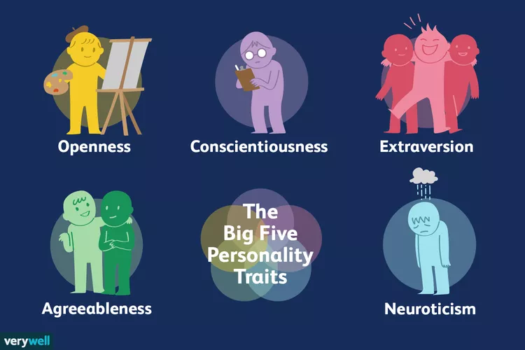

Slide 15

Attitude
Attitude is defined as a more or less stable set of predisposition of opinion, interest or purpose involving expectancy of a certain kind of experience and readiness with an appropriate response.
Attitudes are also known as “frames of reference”.

Slide 16
Components of Attitude
Cognitive Component
Affective Component
Behavioral Component

Slide 17

Importance of Attitude
Career success
Productivity
Leadership
Teamwork
Decision making
Motivation
Interpersonal relations
Stress management

Slide 18

Functions of Attitude
Adjustment Function
Ego-Defensive Function
Value-Expressive Function
Knowledge Function

Slide 19

TYPES OF WORK RELATED ATTITUDES
Job Satisfaction
Job Involvement
Organisational Commitment

Slide 20
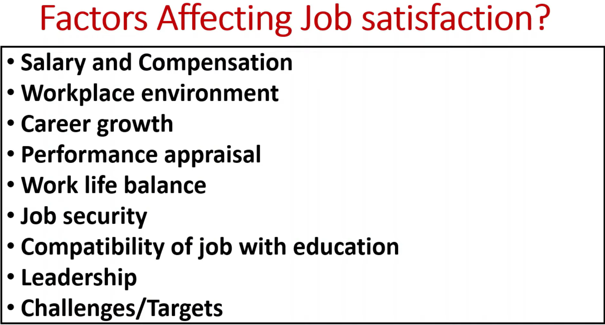

Slide 21


Slide 22
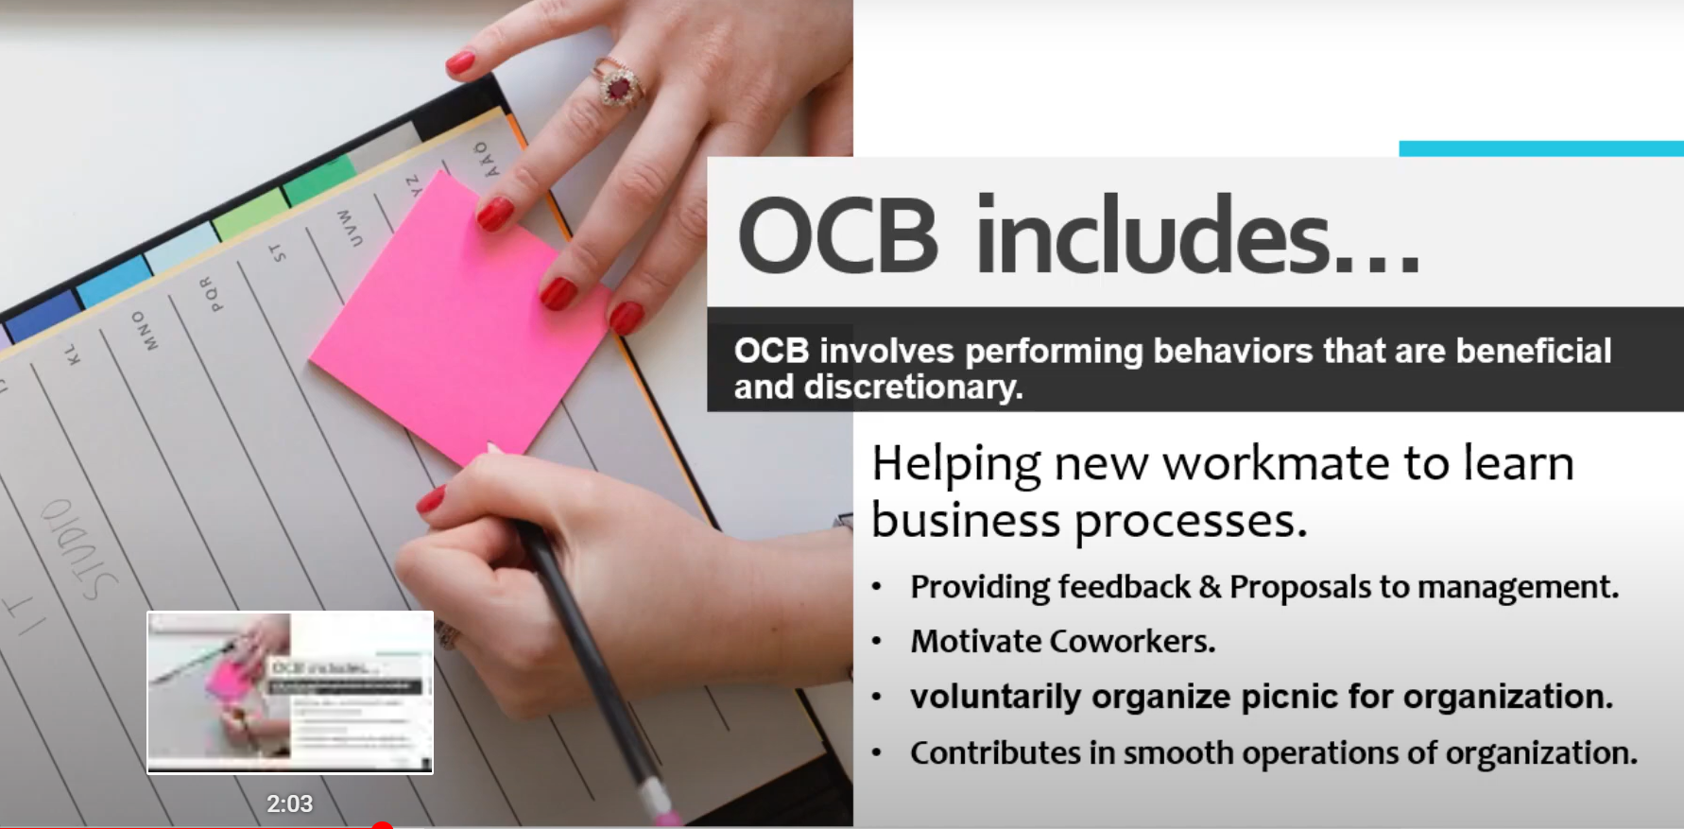

Slide 23

Attitude Formation
Direct Experience
Social Learning

Slide 24
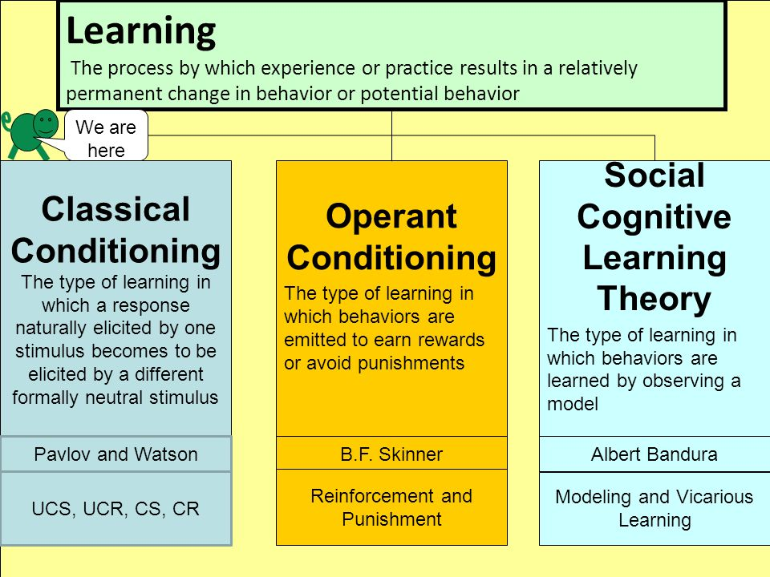

Slide 25
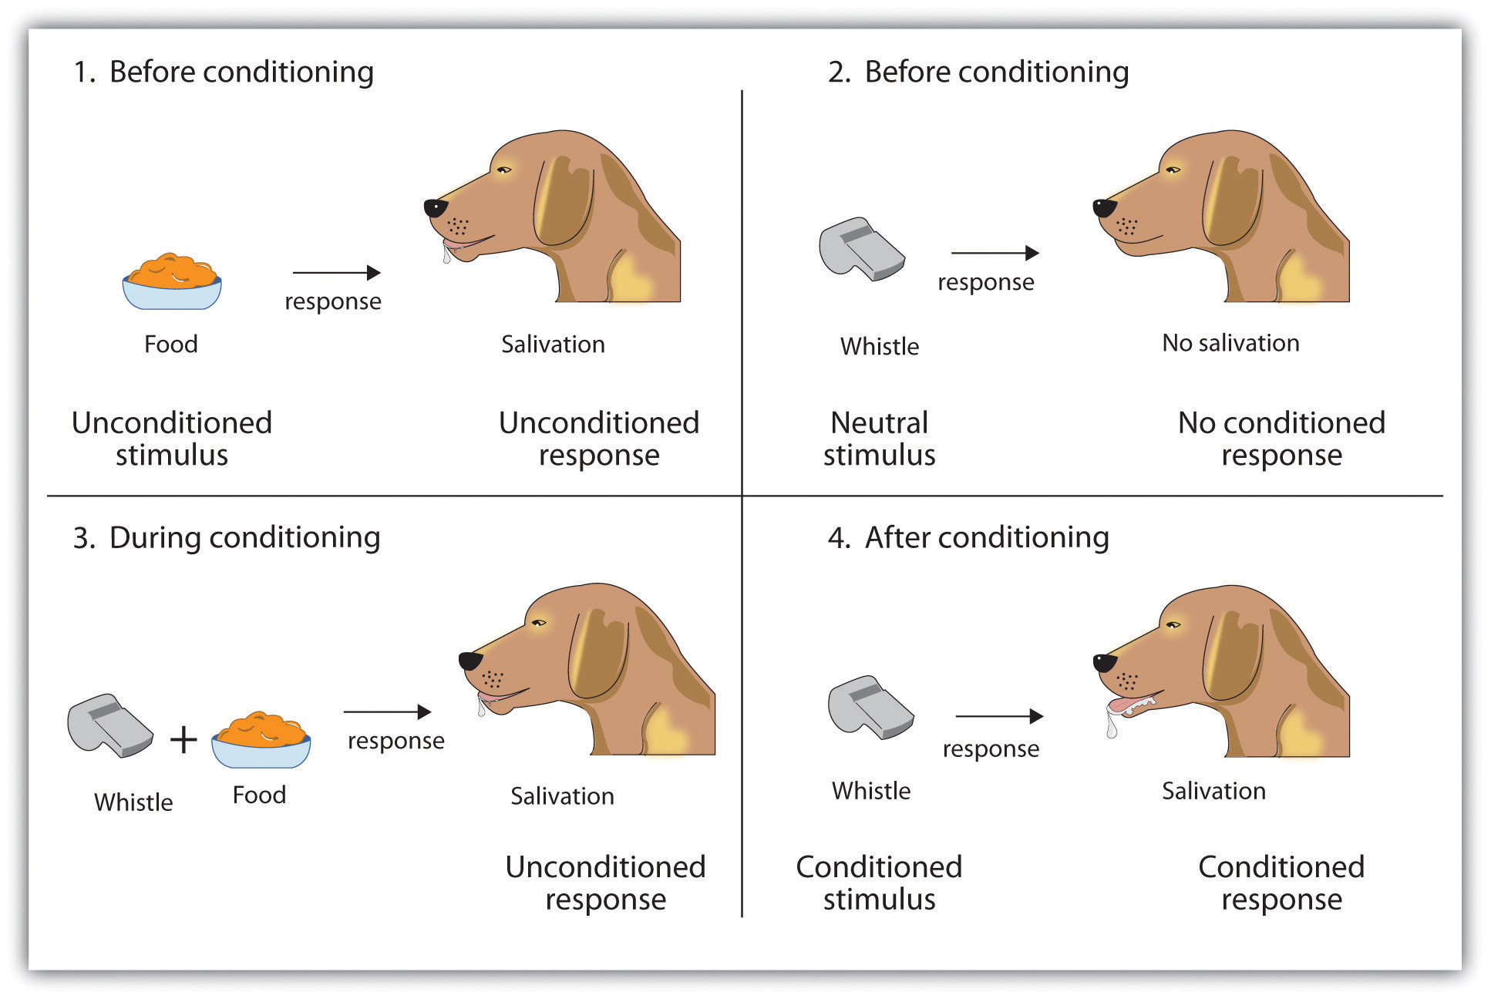
Classical Conditioning
Stimulus → Response.

Slide 26

Operant Conditioning

Slide 27
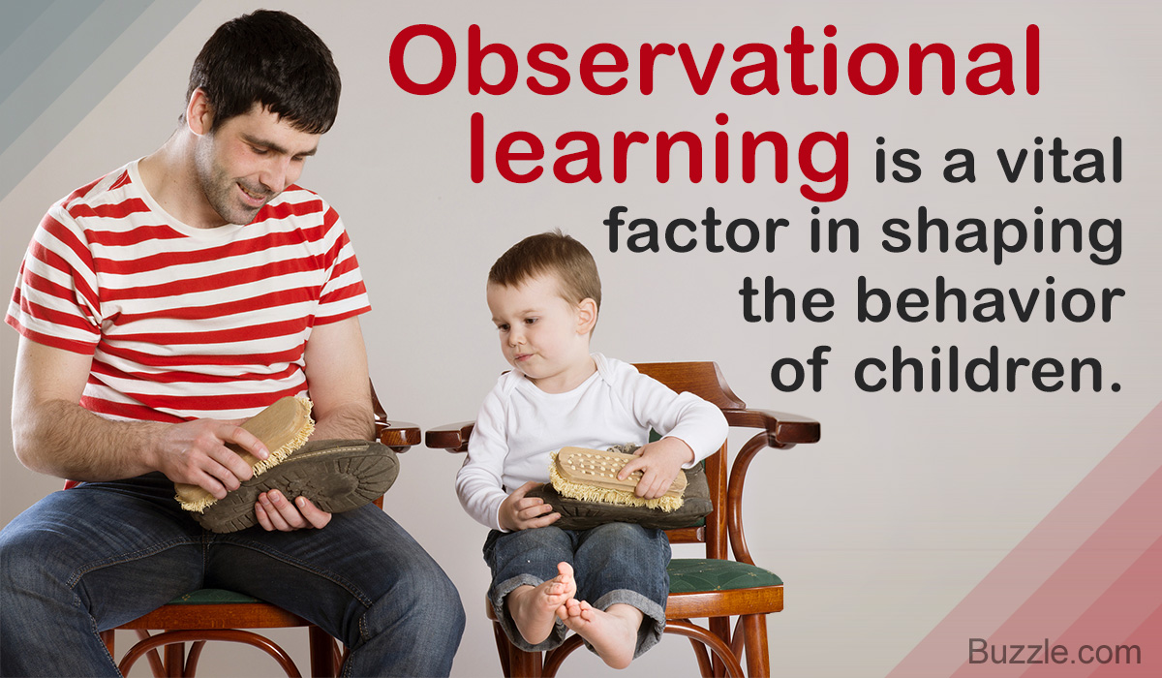

Slide 28
THEORIES OF ATTITUDE
Balance Theory
Cognitive Dissonance Theory
Congruity Theory
Affective Cognitive Consistency Theory

Slide 29
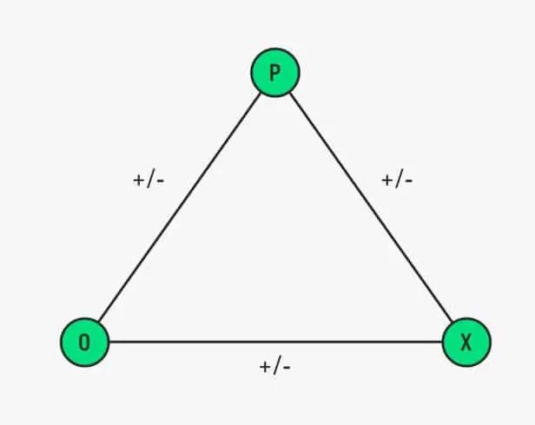
Balance Theory

Slide 30
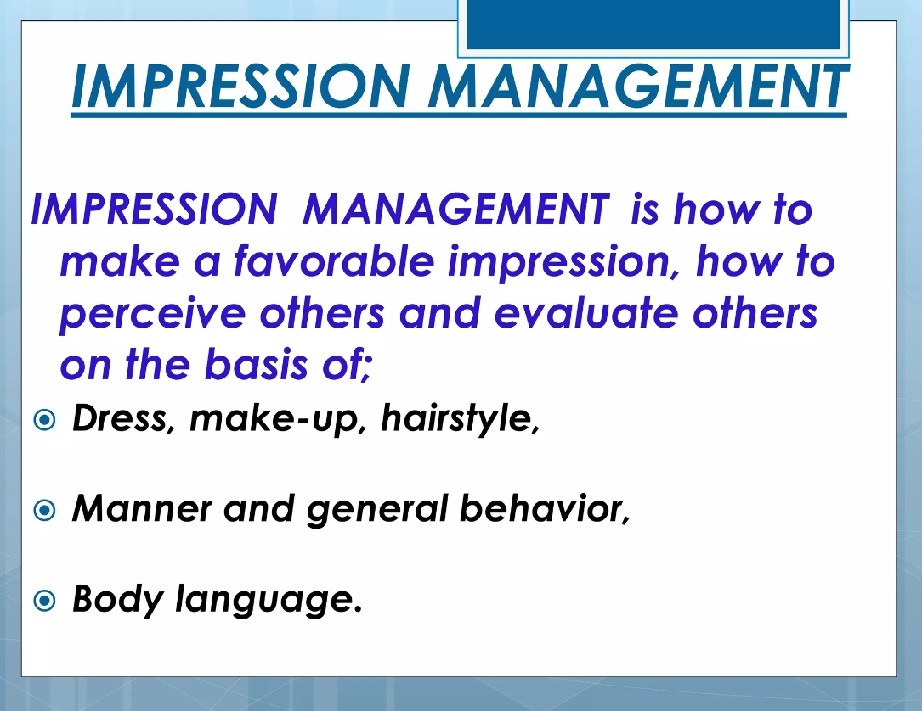

Slide 31
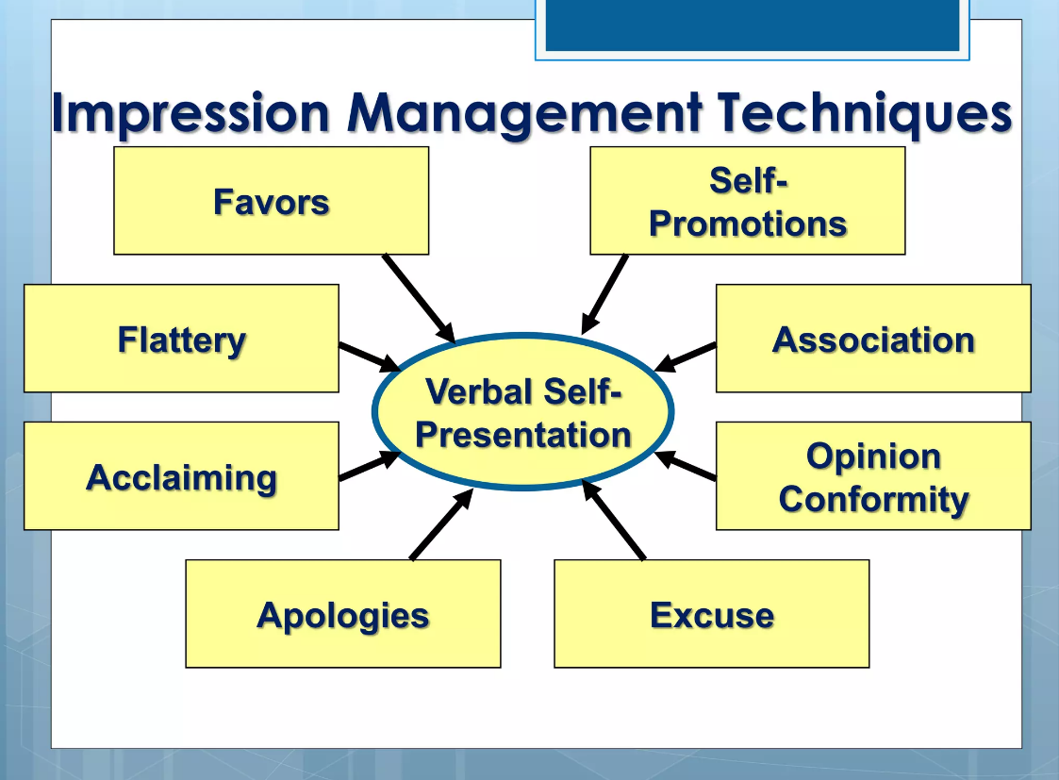

Slide 32
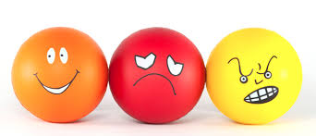
Emotion
An emotion is a mental and physiological state associated with a wide variety of feelings, thoughts, and behavior. Emotions are subjective experiences, or experienced from an individual point of view. It is often associated with mood, temperament, personality, and disposition.

Slide 33
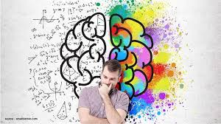
Emotional Intelligence
Emotional Intelligence (EI), often measured as an Emotional Intelligence Quotient (EQ), is a term that describes the ability, capacity, skill or a self perceived ability, to identify, assess, and manage the emotions of one’s self, of others, and of groups.

Slide 34

What is IQ?
An intelligence quotient, or IQ, is a score derived from one of several different standardized tests designed to assess intelligence.

Slide 35
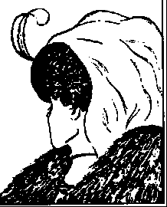
Perceptual Process
Perception is the process of interpreting and understanding one’s environment.
It is a complex psychological process, but it can be boiled down to four steps:
Observation,
Selection,
Organisation
Interpretation

Slide 36

PERCEPTUAL GROUPING
Perceptual grouping refers to the process of determining which regions and parts of the visual scene belong together as parts of higher order perceptual units such as objects or patterns.

Slide 37

Motivation
“The processes that account for an individual’s intensity, direction, and persistence of effort toward achieving a goal”

Slide 38

Approaches of Motivation
Behavioral Approach
Cognitive & Social Cognitive Approach
Attribution Approach
Humanistic Approach

Slide 39
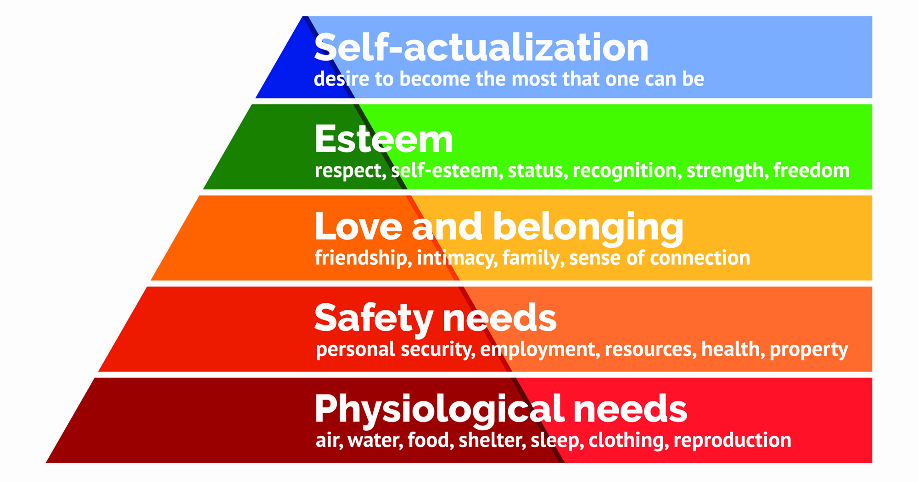
Maslow's Theory of Motivation

Slide 40
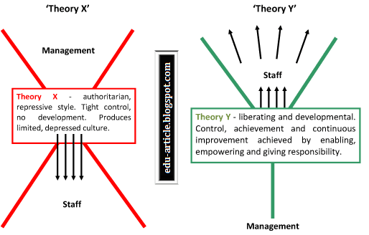

Slide 41


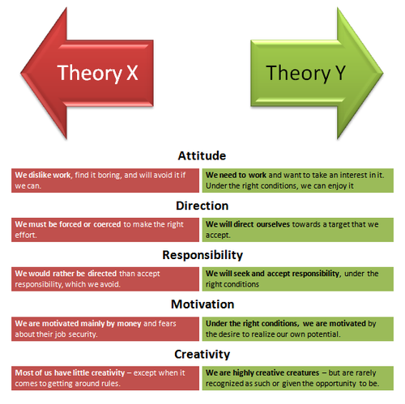

Slide 42
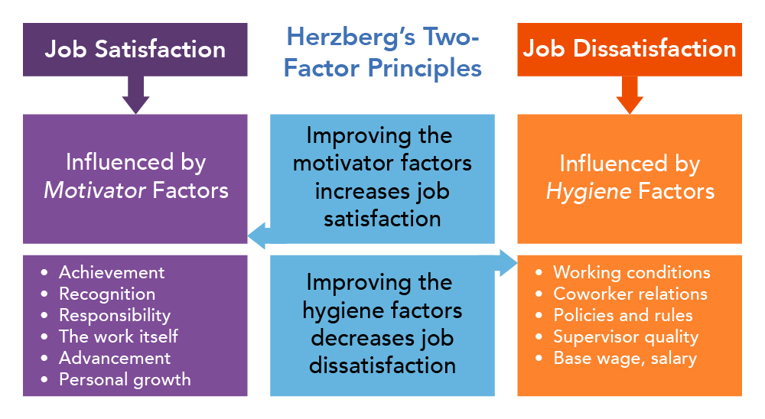

Slide 43
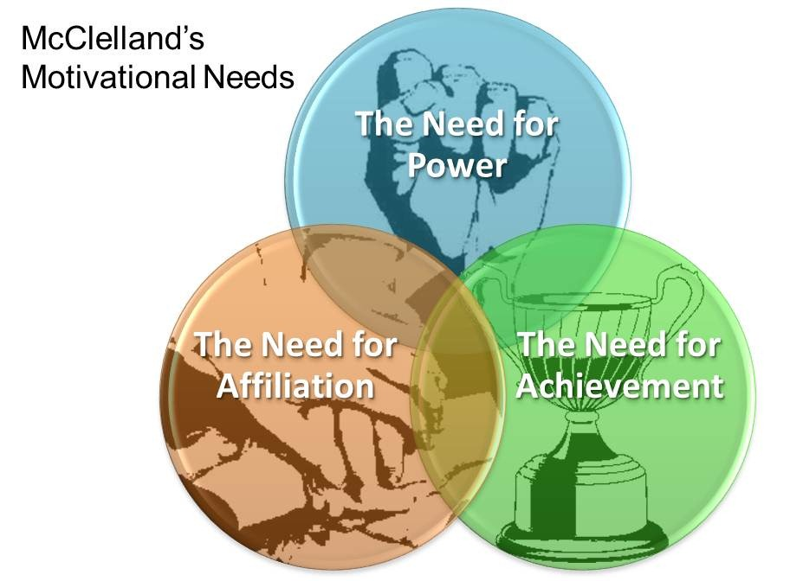

Slide 44
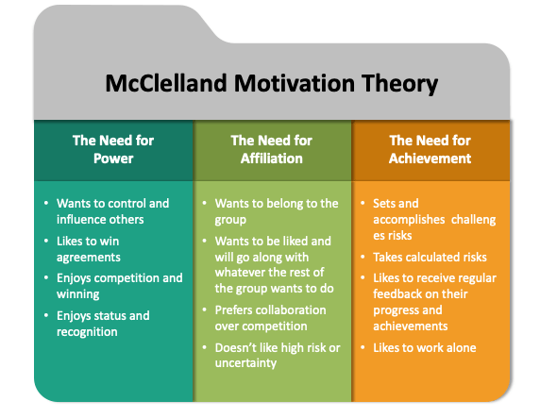

Slide 45
Importance of Motivation
Lead to profitable operation
High level of productivity
Best remedy for resistance to change
Satisfaction of employees
Minimize disputes and strikes
Basis of coordination
Stability of workforce

Slide 46
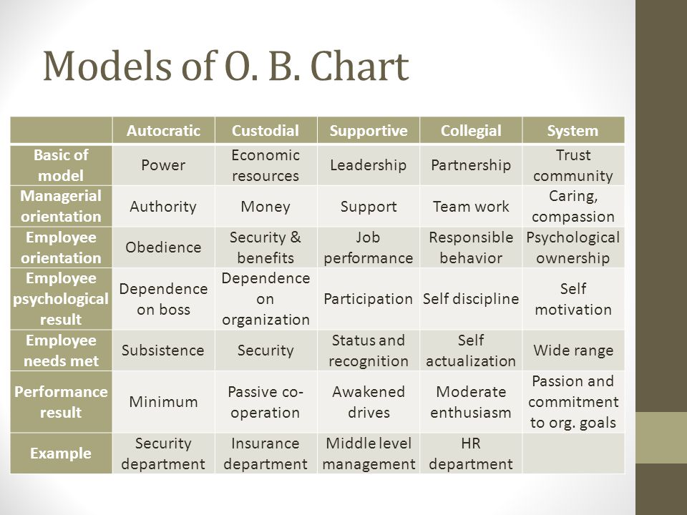
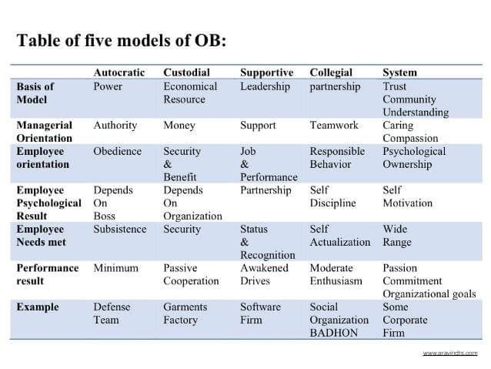
ORGANIZATIONAL BEHAVIOUR MODEL

